Slide 1
Not suggested SUT
2021/09/08

Slide 2
1.分散式系統 (Distributed system) 2.系統軟體(System software, e.g.TCP/IP) 3.遊戲軟體(Game) 4.相片編輯(Image editor)

Slide 3
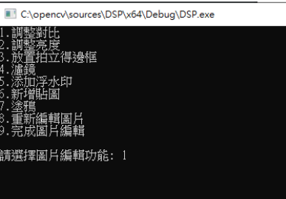
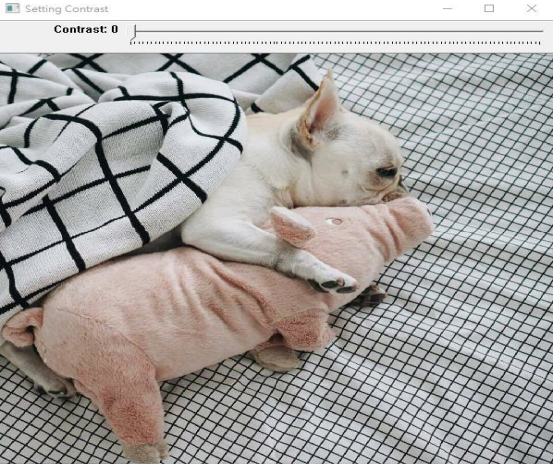
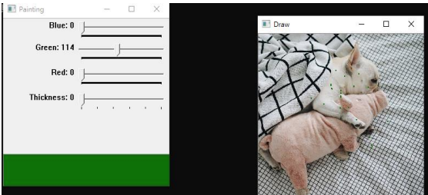
Image Editor
It’s not easy to check if the software is working correctly

